Slide 1
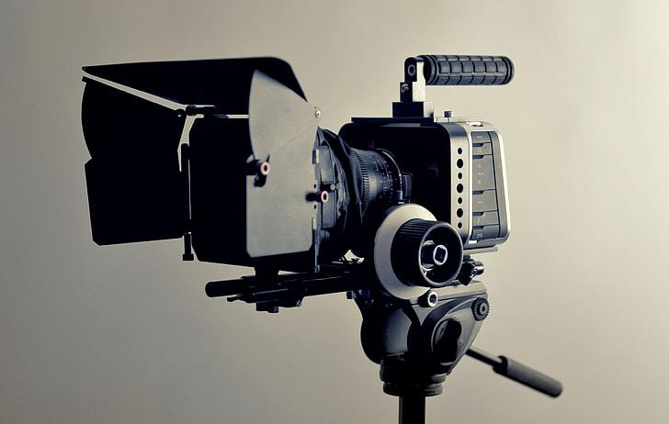
Filmmaking & Technology
Introduction to Research
Kevin Shreenauth

Slide 2
Research Question
How have technological advancements impacted the world of filmmaking, both in the physical hardware used to film motion pictures and the software technologies used in post-production?

Slide 3
Key Definitions
Film Hardware → Camera, Lighting, Audio Equipment, etc.
Film Software → Editing, AI algorithms, CGI, VR/AR, Animation, etc.
Post-Production → Technology used to edit pre-recorded film

Slide 4
Research Objective
To investigate the role technology has in both the physical filmmaking process and post-production softwares in the past, present, and future through the respective technological advancements made and their impacts on the filmmaking process.
Past - film cameras vs digital
Present - CGI/Animation
Future - VR/AR in filmmaking

Slide 5
Hypothesis
Technological advancements in digital cameras, CGI, AI, and various editing softwares have significantly enhanced the filmmaking process by improving the quality and efficiency of production, enabling directors to continue to push the limit of creative storytelling through motion pictures

Slide 6

Research Methods
Literature Review
DataBases used: Ebscohost Academic Search Premier, Google Scholar
Important Qualitative Data Summary:
Physical Filmmaking Advancements
Ang Lee [Evolution - Hulk (2003), Brokeback Mountain (2005), Life of Pi (2012)]
Animation/AI Advancements
AI/Machine Learning [Scripting, VFX scene element identification]
Post-Production Advancements
VR’s possible Application of Post-Production [Virtual Production Editing Tool (VPET)]
Ang Lee

Slide 7
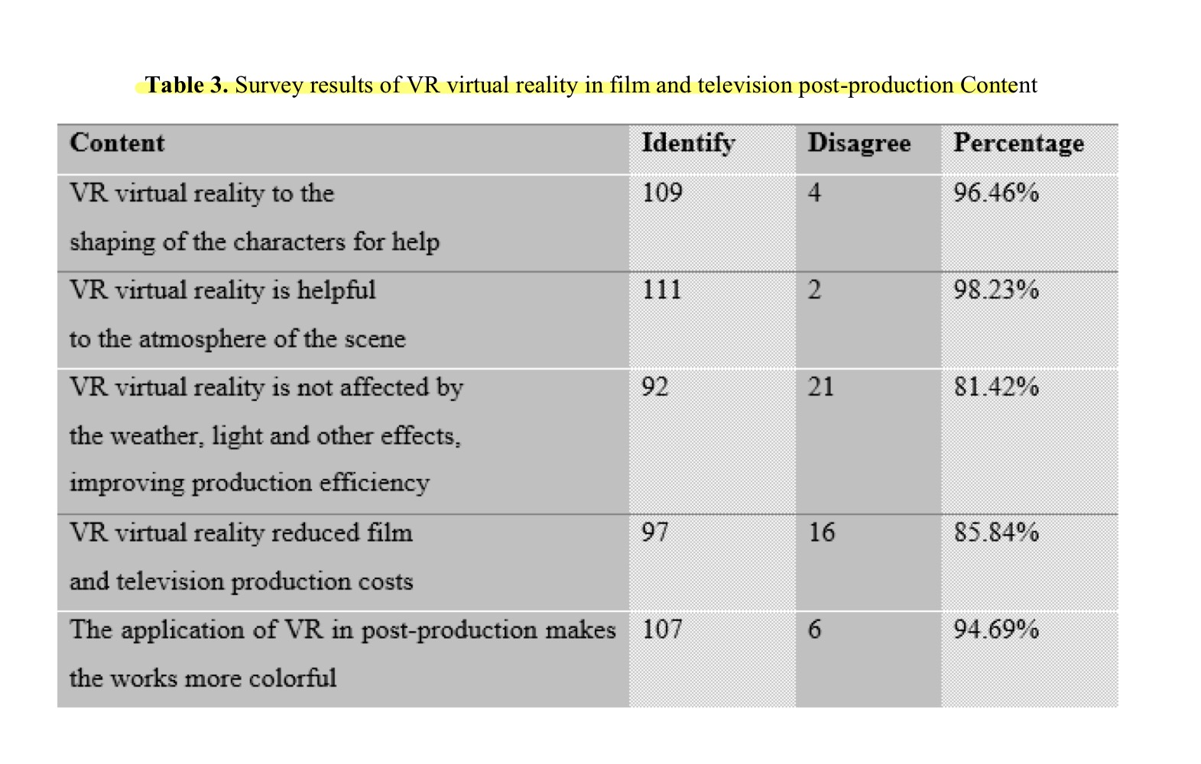
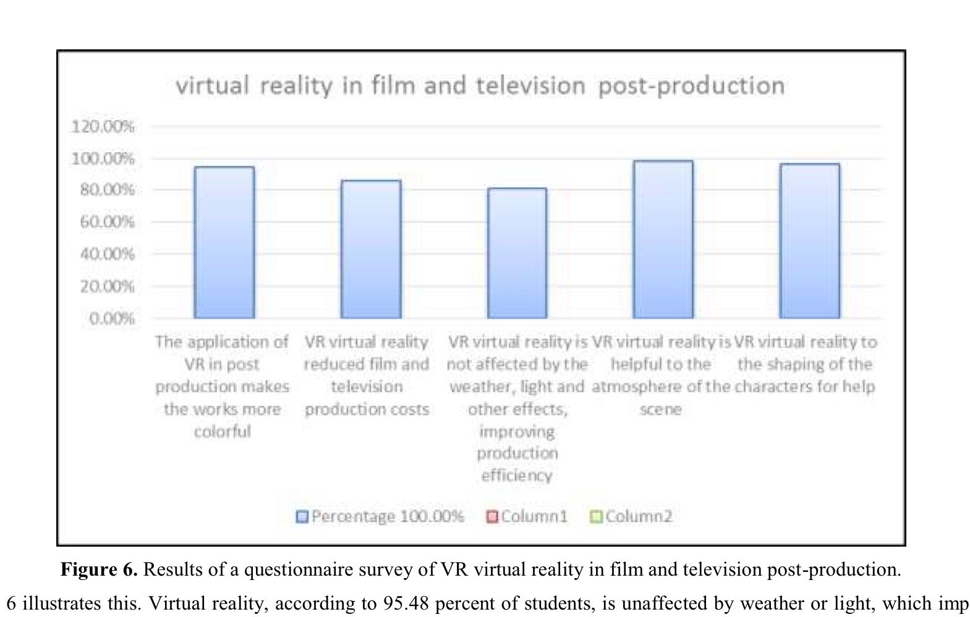
Figures from Literature Review
Results from Survey on VR’s potential aid in film production

Slide 8
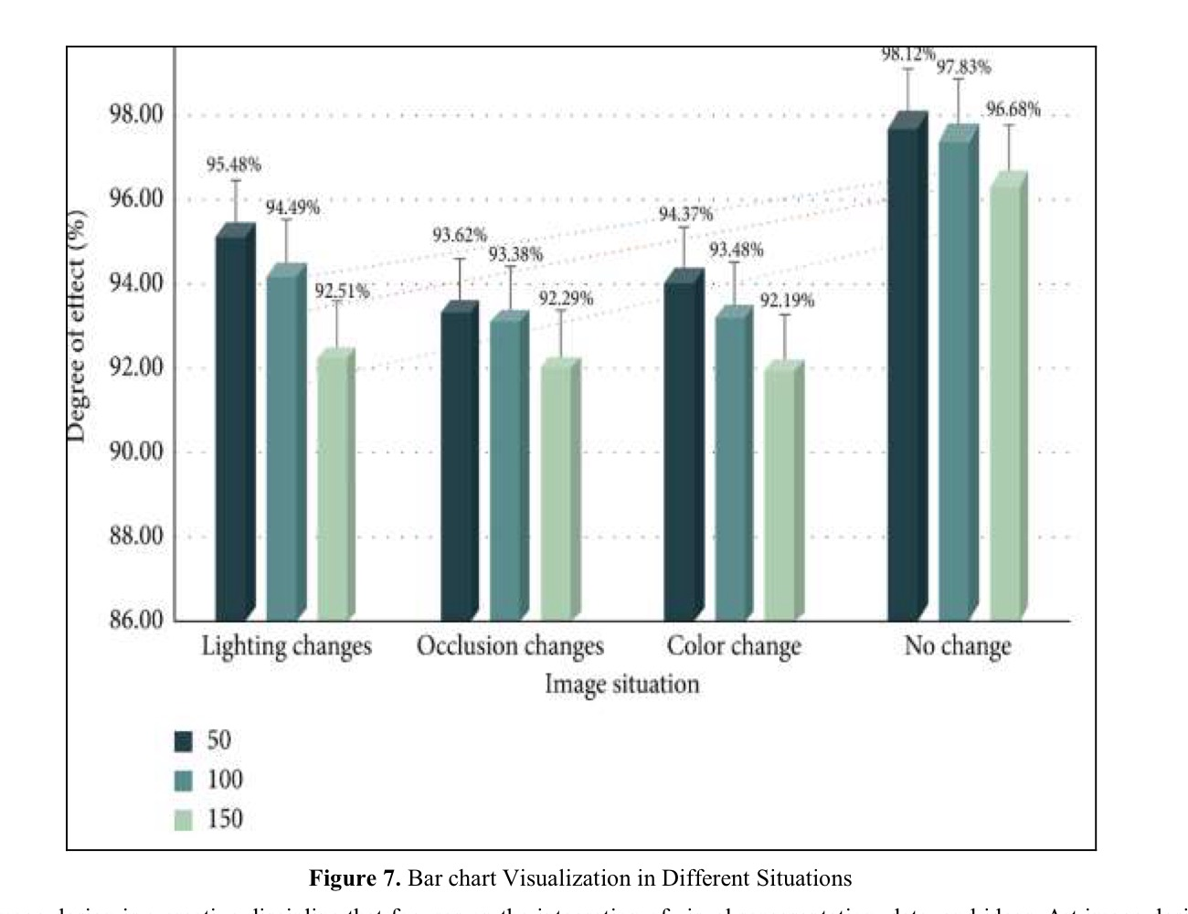
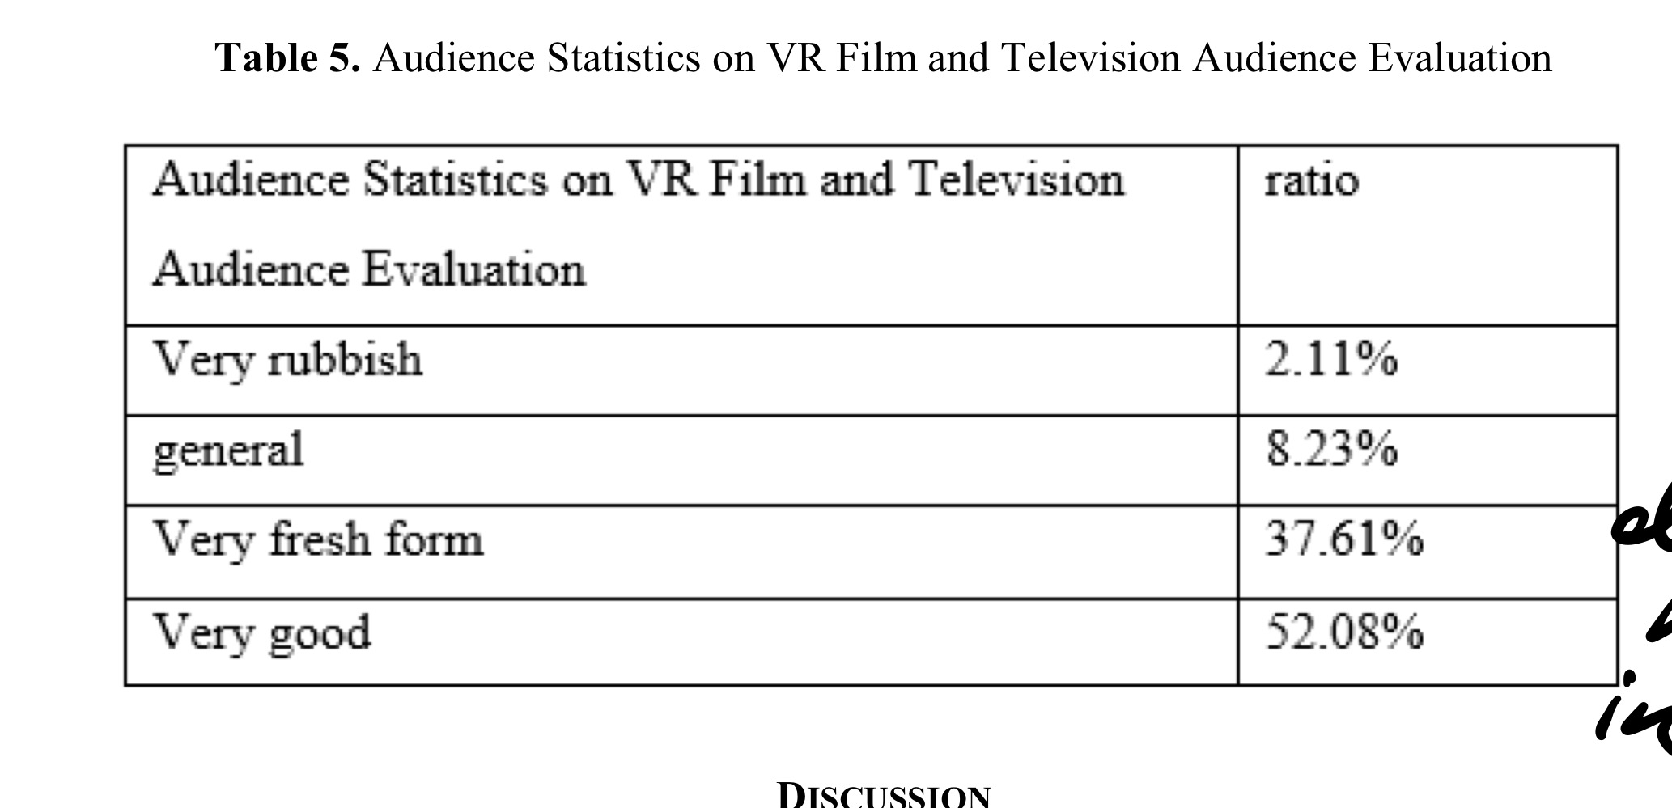
Figures from Lit Review (Cont.)

Slide 9
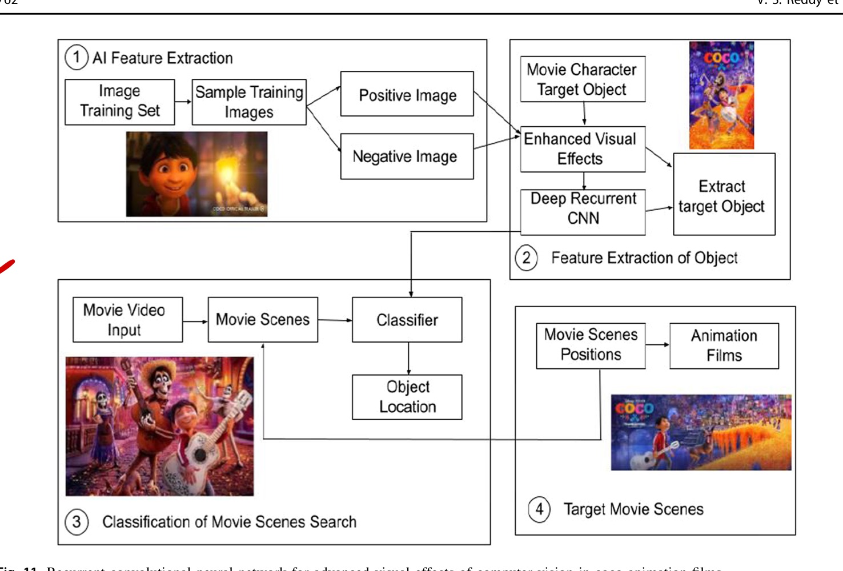
Figures From Literature Review
Figure that sums up how AI algorithms in one my sources plays into post production

Slide 10


Research Methods (cont.)
Case Study
Reviewing Films that debut certain film tech advancements and detailing how it aided the film?
Avatar (2009) James Cameron
3D motion capture technology
District 9 (2009)
Similar Sci-fi movie that was made with traditional filmmaking techniques to achieve 3D figures (smaller budget, tighter crew)
Notes:
Behind the Scenes of One of the Most Iconic Sci-fi Films of Our Times - The Making of District 9 — Animatrik Film Design

Slide 11
How I Plan to Use Case Study Data
This Case Study will allow me to give a contribution to my own research
Both released in the same year and are both Sci-fi films
District 9 did not have the same tech advancements of Avatar
Look at the behind the scenes footage and sources out there to compare and contrast the two production times and qualities to see if a significant improvement was made
Perhaps generate some sort of visual representation to display my findings (if I can find numerical data).

Slide 12
Sources
Photograph of Ang Lee at the 85th Annual Oscars press room. (n.d.). AceShowbiz. http://www.aceshowbiz.com/images/wennpic/ang-lee-85th-annual-oscars-press-room-02.jpg
Ming, X. M. (2022). Post-production of digital film and television with development of virtual reality image technology-advance research analysis. Int. J. Mech. Eng, 7.
Avatar [Movie poster]. (2009). The Movie Database. https://image.tmdb.org/t/p/original/8Y7WrRK1iQHEX7UIftBeBMjPjWD.jpg
District 9 [Movie poster]. (n.d.). The Movie Database. https://www.themoviedb.org/t/p/original/kYkK0KIBygtYQzBpjMgQyya4Re7.jpg

Slide 13
Thank you.
Any Questions?

